Slide 1
Context-Free Languages

Slide 2
Regular Grammar
01* (0+1)*
01(0+1)*
Letter followed by digit
Start and end with a
Generate all even integer upto 998
Alternate letters
a^2n
(ab)^n
{ 0 1 2,1 2 0, 2 0 1} generate these strings
a^n b^m c^0
Courtesy Costas Busch - RPI

Slide 3

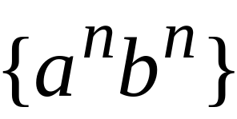
Context-Free Languages
Regular Languages
Courtesy Costas Busch - RPI

Slide 4
Context-Free Languages
Context-Free
Grammars
Pushdown
Automata
stack
automaton
Courtesy Costas Busch - RPI

Slide 5
Context-Free Grammars
Courtesy Costas Busch - RPI

Slide 6
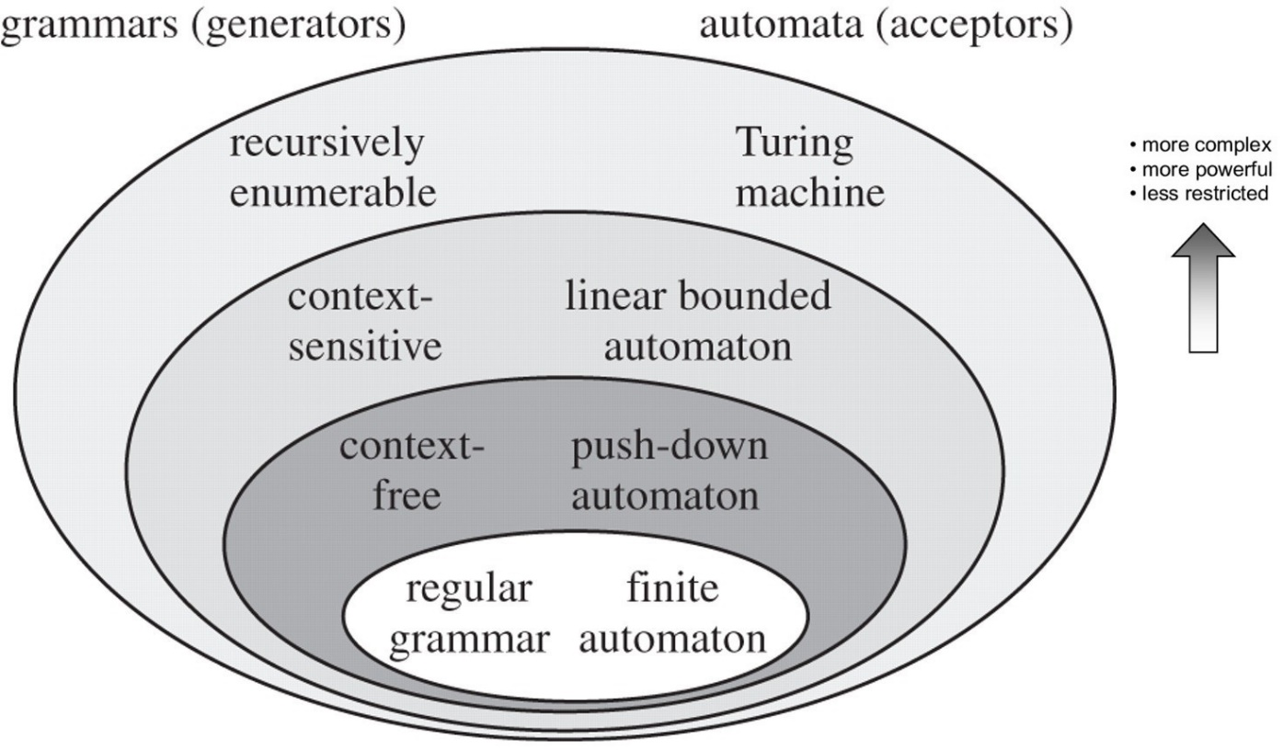
Courtesy Costas Busch - RPI

Slide 7


Example
A context-free grammar :
One non terminal → terminal/non terminal
A derivation:
Courtesy Costas Busch - RPI

Slide 8
A context-free grammar :
Another derivation:
Courtesy Costas Busch - RPI

Slide 9


Courtesy Costas Busch - RPI

Slide 10
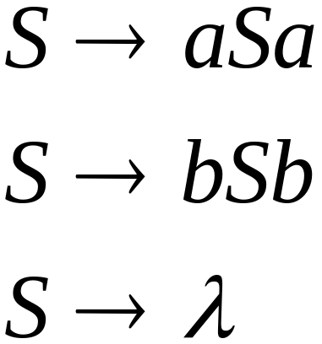
Example
A context-free grammar :
A derivation:
Courtesy Costas Busch - RPI

Slide 11
A context-free grammar :
Another derivation:
Courtesy Costas Busch - RPI

Slide 12
Courtesy Costas Busch - RPI

Slide 13

Courtesy Costas Busch - RPI

Slide 14
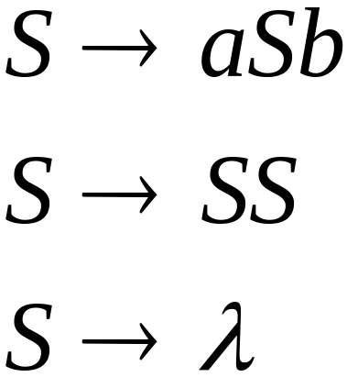
Example
A context-free grammar :
A derivation:
Courtesy Costas Busch - RPI

Slide 15
A context-free grammar :
A derivation:
Courtesy Costas Busch - RPI

Slide 16
Courtesy Costas Busch - RPI

Slide 17
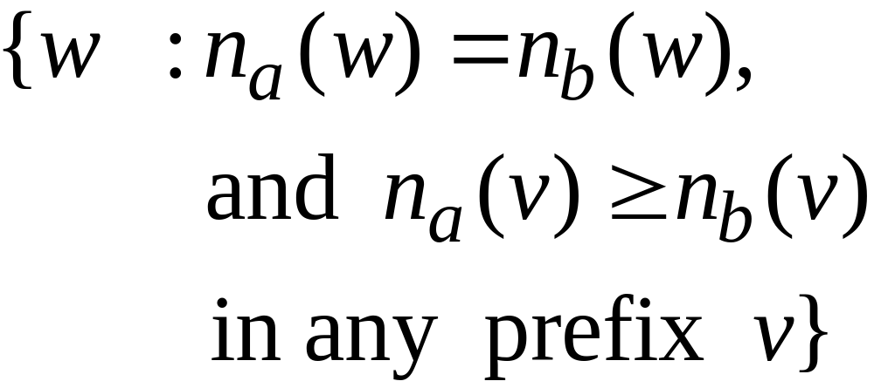
Courtesy Costas Busch - RPI

Slide 18

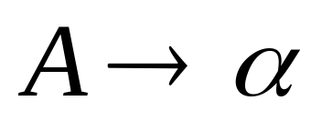

Definition: Context-Free Grammars
Grammar
Variables
Terminal
symbols
Start
variables
Productions of the form:
is string of variables and terminals
Courtesy Costas Busch - RPI

Slide 19
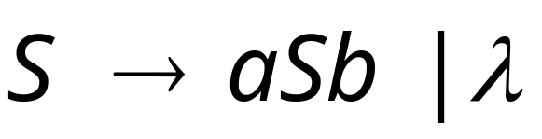




Example of Context-Free Grammar
productions
start variable
variables
terminals
Courtesy Costas Busch - RPI

Slide 20
Notation: Context-Free Grammars
Lower case letters near beginning of alphabet
(e.g. a, b, c, …) are terminal symbols
Upper case letters near beginning of alphabet
(e.g. A, B, C, …) are variables
Lower case letters near end of alphabet
(e.g. w, x, …) are strings of terminals
Upper case letters near end of alphabet
(e.g. X, Y, …) are either terminals or strings
Lower case Greek letters
(e.g. α, β, γ, …) are strings of terminals and/or variables
Courtesy Costas Busch - RPI

Slide 21

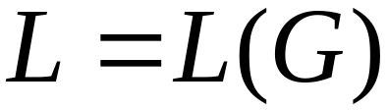
Definition: Context-Free Languages
A language is context-free
if and only if
there is a grammar with
Courtesy Costas Busch - RPI

Slide 22


Recall
Language of a Grammar
For a grammar
with start variable :
String of terminals
Courtesy Costas Busch - RPI

Slide 23
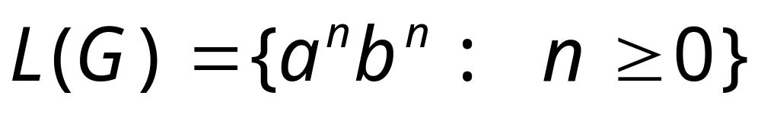
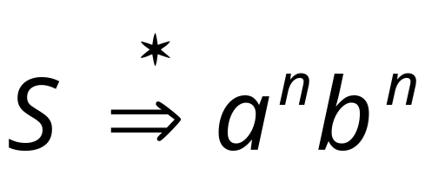
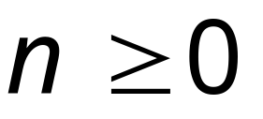
Example:
context-free grammar :
Since, there is derivation
for any
Courtesy Costas Busch - RPI

Slide 24
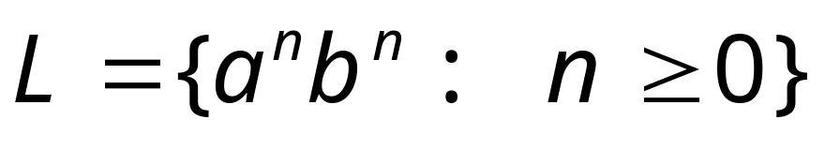
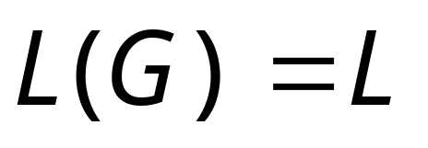
Example:
is a context-free language
since context-free grammar :
generates
Courtesy Costas Busch - RPI

Slide 25

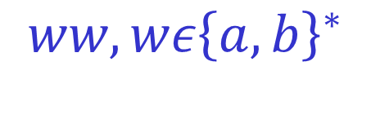





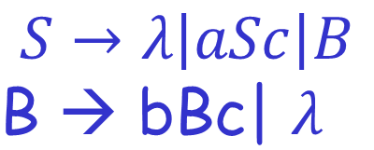
Examples
Courtesy Costas Busch - RPI

Slide 26

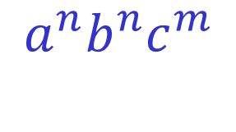

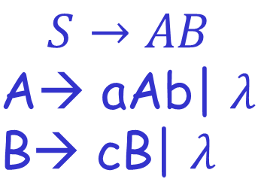


Courtesy Costas Busch - RPI

Slide 27

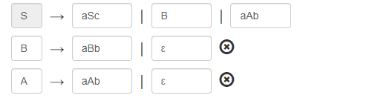
Courtesy Costas Busch - RPI

Slide 28
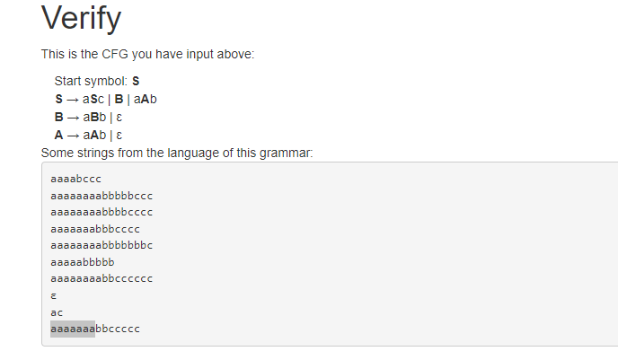
Courtesy Costas Busch - RPI

Slide 29

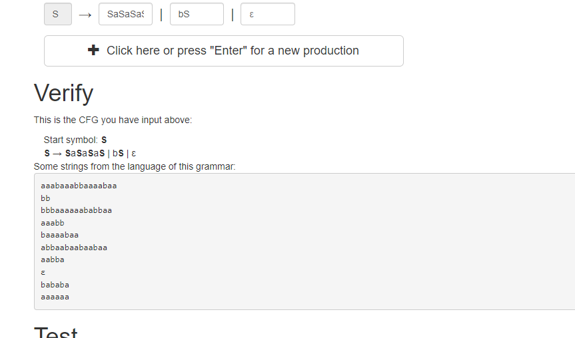
Courtesy Costas Busch - RPI

Slide 30

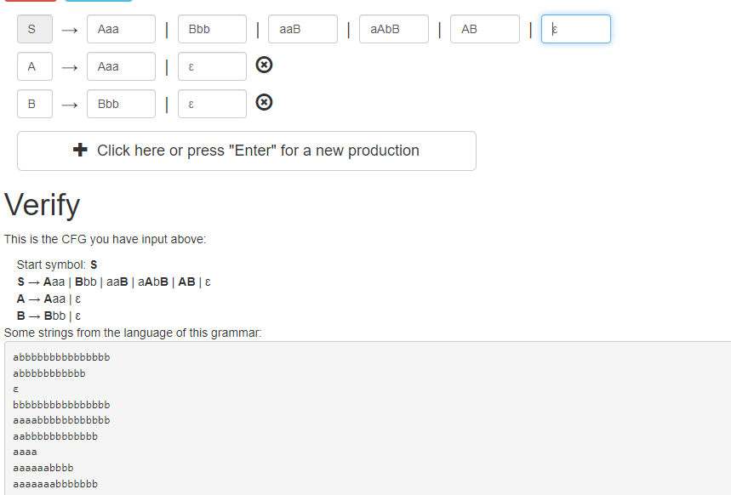
Courtesy Costas Busch - RPI

Slide 31
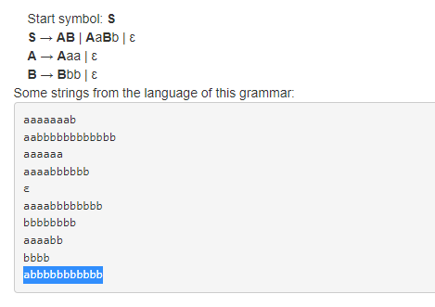
Simplified Version
Courtesy Costas Busch - RPI

Slide 32
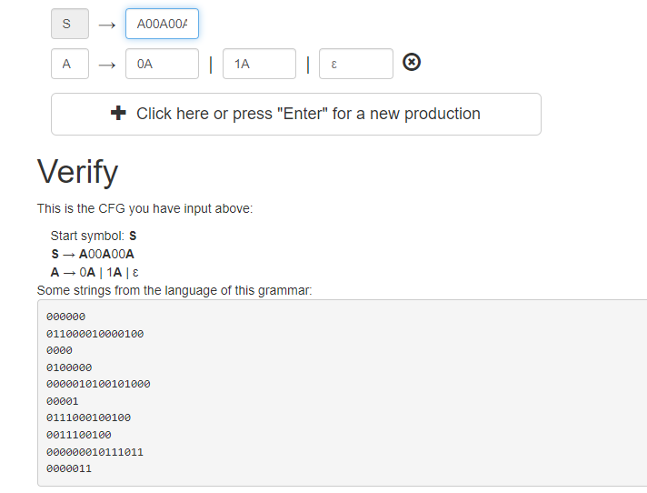
Courtesy Costas Busch - RPI

Slide 33

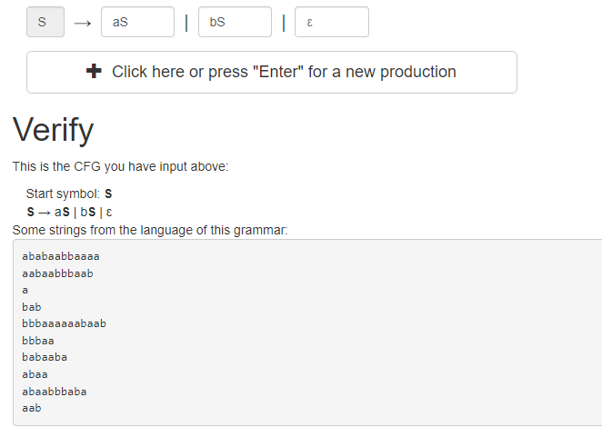
Courtesy Costas Busch - RPI

Slide 34
Derivation Order and
Derivation Trees

Slide 35
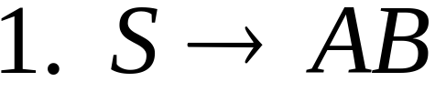
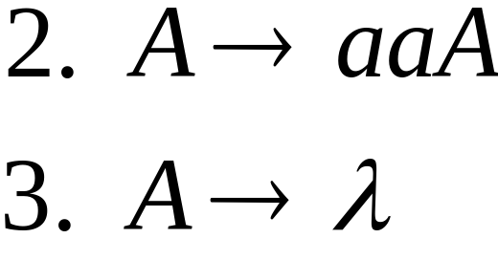
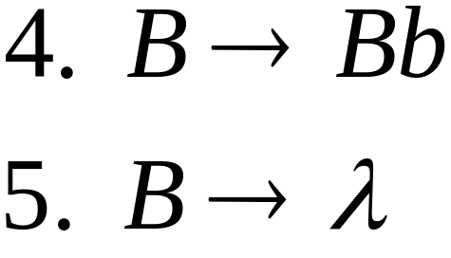
Derivation Order
Consider the following example grammar
with 5 productions:
Derive a string aab
Courtesy Costas Busch - RPI

Slide 36
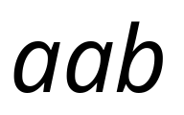

Leftmost derivation order of string :
At each step, we substitute the
leftmost variable
Courtesy Costas Busch - RPI

Slide 37

Rightmost derivation order of string :
At each step, we substitute the
rightmost variable
Courtesy Costas Busch - RPI

Slide 38
Leftmost derivation of :
Rightmost derivation of :
Courtesy Costas Busch - RPI

Slide 39
Derivation Trees

Slide 40

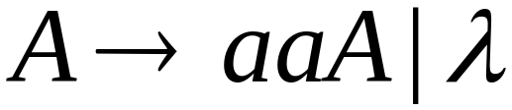
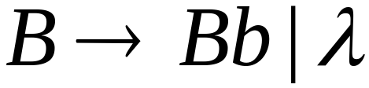




Courtesy Costas Busch - RPI

Slide 41


Courtesy Costas Busch - RPI

Slide 42

Courtesy Costas Busch - RPI

Slide 43

Courtesy Costas Busch - RPI

Slide 44
Derivation Tree
Courtesy Costas Busch - RPI

Slide 45
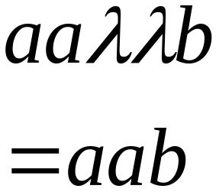
Derivation Tree
yield
Courtesy Costas Busch - RPI

Slide 46
Partial Derivation Trees
Partial derivation tree
Courtesy Costas Busch - RPI

Slide 47
Partial derivation tree
Courtesy Costas Busch - RPI

Slide 48

sentential
form
Partial derivation tree
yield
Courtesy Costas Busch - RPI

Slide 49
Sometimes, derivation order doesn’t matter
Leftmost:
Rightmost:
Same derivation tree
Courtesy Costas Busch - RPI

Slide 50
Ambiguity
Courtesy Costas Busch - RPI

Slide 51
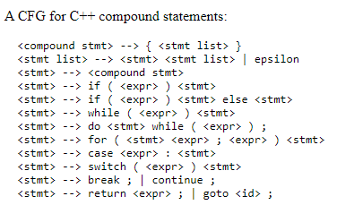
Courtesy Costas Busch - RPI

Slide 52
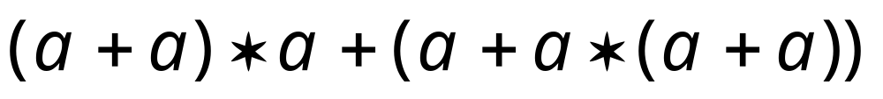
Grammar for mathematical expressions
Example strings:
Denotes any number
Courtesy Costas Busch - RPI

Slide 53





A leftmost derivation
for
Courtesy Costas Busch - RPI

Slide 54

Another
leftmost derivation
for
Courtesy Costas Busch - RPI

Slide 55
Two derivation trees
for
Courtesy Costas Busch - RPI

Slide 56
The grammar
is ambiguous:
string
has two derivation trees
Courtesy Costas Busch - RPI

Slide 57
The grammar
is ambiguous:
string
has two leftmost derivations
Courtesy Costas Busch - RPI

Slide 58

Definition:
A context-free grammar is ambiguous
if some string has:
two or more derivation trees
Courtesy Costas Busch - RPI

Slide 59
In other words:
A context-free grammar is ambiguous
if some string has:
two or more leftmost derivations
(or rightmost)
Courtesy Costas Busch - RPI

Slide 60

Why do we care about ambiguity?
take
Courtesy Costas Busch - RPI

Slide 61


Courtesy Costas Busch - RPI

Slide 62





Courtesy Costas Busch - RPI

Slide 63
Correct result:
Courtesy Costas Busch - RPI

Slide 64
Ambiguity is bad for programming languages
We want to remove ambiguity
Courtesy Costas Busch - RPI

Slide 65
Ambiguous Grammar:
A context-free grammar is ambiguous
if there is a string which has:
two different derivation trees
or
two leftmost derivations
(Two different derivation trees give two
different leftmost derivations and vice-versa)
Courtesy Costas Busch - RPI

Slide 66
In general, ambiguity is bad
and we want to remove it
Sometimes it is possible to find
a non-ambiguous grammar for a language
But, in general ιt is difficult to achieve this
Courtesy Costas Busch - RPI

Slide 67
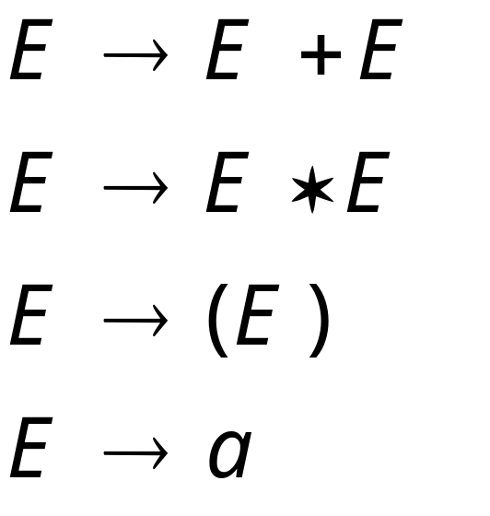
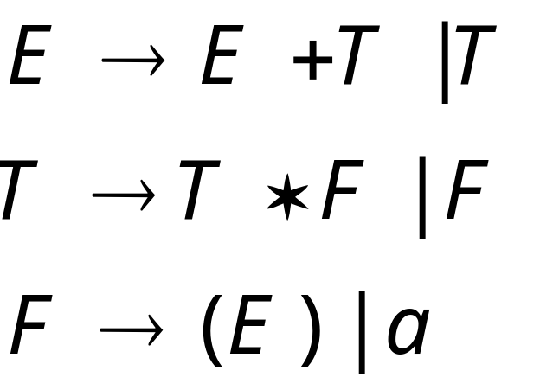
A successful example:
Equivalent
Ambiguous
Grammar
Non-Ambiguous
Grammar
generates the same
language
Courtesy Costas Busch - RPI

Slide 68

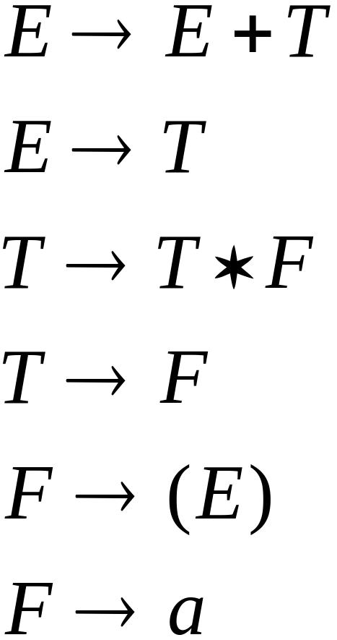


Courtesy Costas Busch - RPI

Slide 69
Unique derivation tree
Courtesy Costas Busch - RPI

Slide 70
The grammar :
is non-ambiguous:
Every string has
a unique derivation tree
Courtesy Costas Busch - RPI

Slide 71
Ambiguous Grammar
S -> aSb | SS | e
left derivation
S-> aSb-> aaSbb -> aaebb
Left Derivation
S -> SS -> aSbe -> aaSbb -> aabb
2. S -> iCtS | iCt SeS
C -> b S-> a check for string”ibt ibt aea”
3. S -> AB |aaB
A -> a |Aa
B -> b check for string aab
Courtesy Costas Busch - RPI

Slide 72
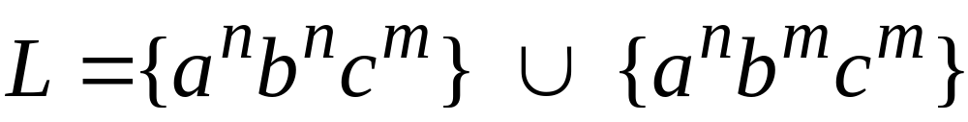

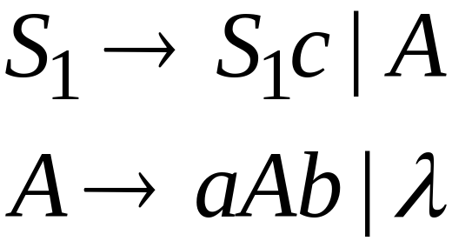
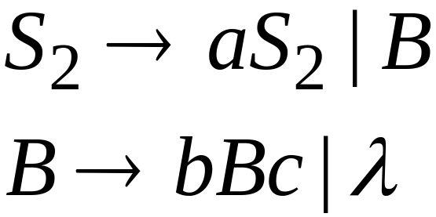
Inherent Ambiguity
Some context free languages
have only ambiguous grammars
Example:
Courtesy Costas Busch - RPI

Slide 73

Another ambiguous grammar:
IF_STMT
if EXPR then STMT
if EXPR then STMT else IF_STMT
Variables
Terminals
Very common piece of grammar
in programming languages
Courtesy Costas Busch - RPI

Slide 74
If expr1 then if expr2 then stmt1 else stmt2
IF_STMT
if
expr1
then
STMT
if
expr2
then
stmt1
else
stmt2
Two derivation trees
IF_STMT
if
expr1
then
STMT
else
stmt2
if
expr2
then
stmt1
Courtesy Costas Busch - RPI

Slide 75


An un-successful example:
is inherently ambiguous:
every grammar that generates this
language is ambiguous
Courtesy Costas Busch - RPI

Slide 76
Simplifications of
Context-Free Grammars

Slide 77
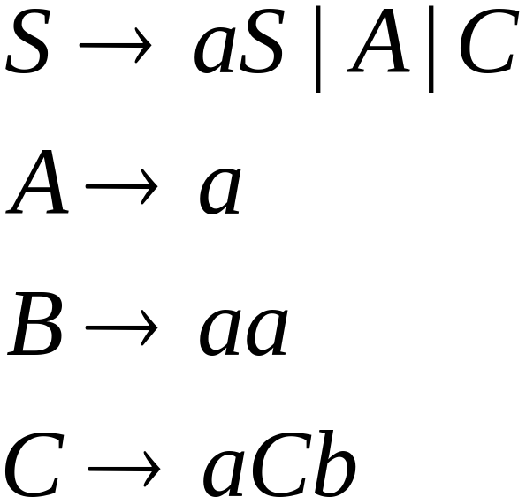
Removing Useless Productions
Example Grammar:
Courtesy Costas Buch - RPI

Slide 78
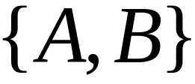

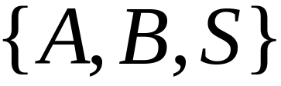
First:
find all variables that can produce
strings with only terminals
Round 1:
Round 2:
Courtesy Costas Buch - RPI

Slide 79
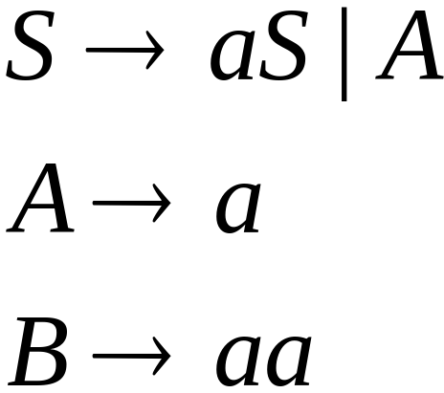
Keep only the variables
that use variables :
(the rest variables are useless)
Remove useless productions
Courtesy Costas Buch - RPI

Slide 80
Second:
Find all variables
reachable from
Use a Dependency Graph
unreachable
Note: nodes are variables
Courtesy Costas Buch - RPI

Slide 81
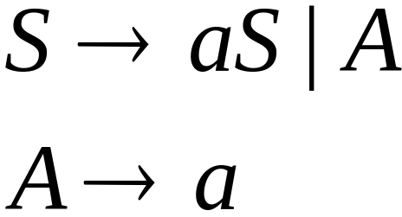
Keep only the variables
reachable from S
(the rest variables are useless)
Final Grammar
Remove useless productions
Courtesy Costas Buch - RPI

Slide 82
Normal Forms for
Context-free Grammars
Courtesy Costas Buch - RPI

Slide 83


Chomsky Normal Form
Each productions has form:
Nonterminal → string of only two Nonterminals
Nonterminal → one terminal
or
variable
variable
terminal
Courtesy Costas Buch - RPI

Slide 84
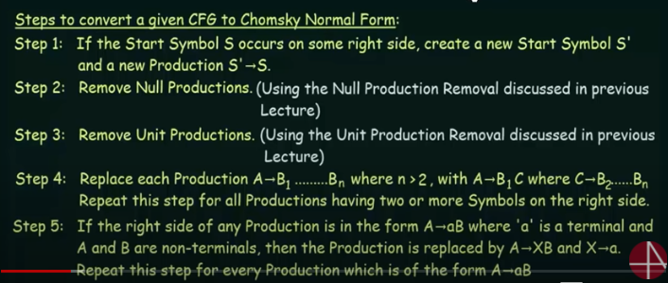
CNF STEPS
Courtesy Costas Busch - RPI

Slide 85
Example
Consider the following CFG for non-empty language:
S → a|aAb|abSb
A → bS| aAAb| Cab | ε
B → ab |AS | ε
D → bS| Cab| ε
a) Simplify showing each steps clearly.
b) Convert the above CFG into CNF.
Courtesy Costas Busch - RPI

Slide 86
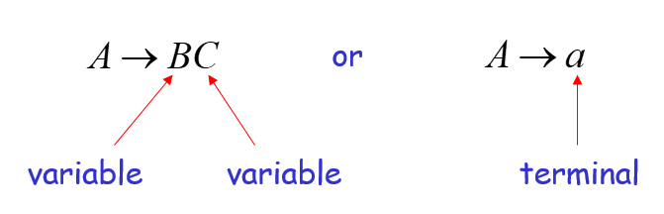
Example
S→ ASA| aB
A→ B| S
B → b |λ
Not in CNF, because it not follow the rules of CNF
Courtesy Costas Busch - RPI

Slide 87
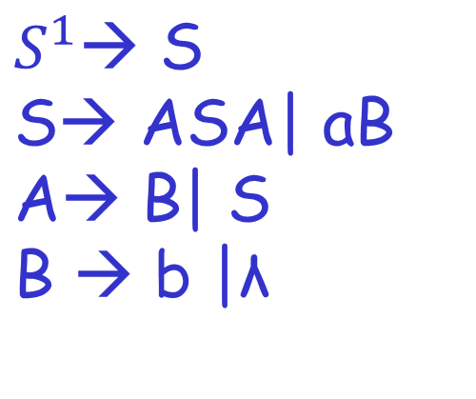
S→ ASA| aB
A→ B| S
B → b |λ
Courtesy Costas Busch - RPI

Slide 88

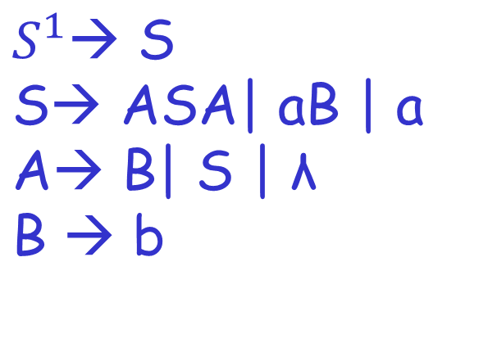
Step # 2 Remove Null Productions
Removing B→ λ
Courtesy Costas Busch - RPI

Slide 89
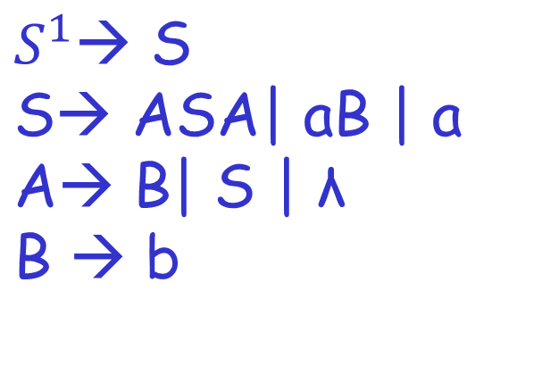
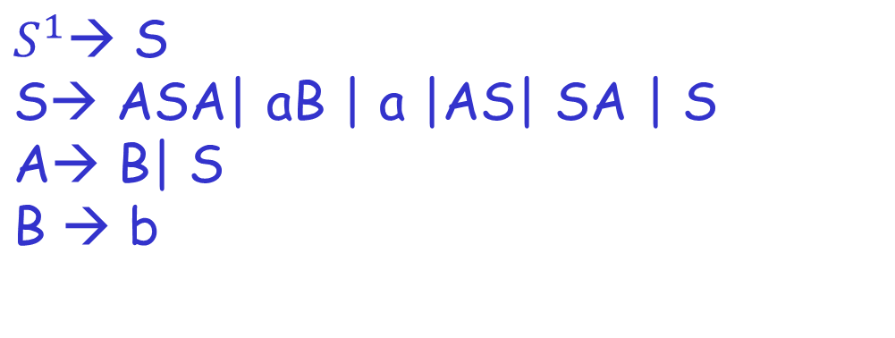
Step # 2 Remove Null Productions
Removing A→ λ
Courtesy Costas Busch - RPI

Slide 90


Step # 3 Remove Unit Productions
Remove S → S
Courtesy Costas Busch - RPI

Slide 91


Step # 3 Remove Unit Productions
Courtesy Costas Busch - RPI

Slide 92


Step # 3 Remove Unit Productions
Remove A→ B
Courtesy Costas Busch - RPI

Slide 93


Step # 3 Remove Unit Productions
Remove A→ S
Courtesy Costas Busch - RPI

Slide 94


Step # 4 Remove More than two variables on RHS
Courtesy Costas Busch - RPI

Slide 95


Step # 5
Courtesy Costas Busch - RPI

Slide 96


Example # 2
Step 1: We will create a new production
S1 → S, as the start symbol S appears on
the RHS.
Courtesy Costas Busch - RPI

Slide 97

Step 2: As grammar G1 contains A → ε null production, its removal from the grammar yields:
Courtesy Costas Busch - RPI

Slide 98

Now, as grammar G1 contains Unit production S → B, its removal yield:
Courtesy Costas Busch - RPI

Slide 99

Also remove the unit production S1 → S, its removal from the grammar yields:
Courtesy Costas Busch - RPI

Slide 100

Step 3: In the production rule S0 → aA | Aa, S → aA | Aa, A → aBB and B → Aa, terminal a exists on RHS with non-terminals. So we will replace terminal a with X:
Courtesy Costas Busch - RPI

Slide 101


Step 4: In the production rule A → XBB, RHS has more than two symbols, removing it from grammar yield:
Courtesy Costas Busch - RPI

